Slide 1
Digital Portfolio
STUDENT NAME: S.Sathishwaran
REGISTER NO AND NMID: asunm11024ai121
DEPARTMENT: B.SC CS with AI
COLLEGE: Dharmamurthi Rao Bahadur Calavala Cunnan Chettys Hindu College, Madras university

Slide 2
PROJECT TITLE
Digital student portfolio

Slide 3


AGENDA
Problem Statement
Project Overview
End Users
Tools and Technologies
Portfolio design and Layout
Features and Functionality
Results and Screenshots
Conclusion
Github Link
3/21/2024 Annual Review

Slide 4

PROBLEM STATEMENT
I created this website to solve a fundamental challenge for any aspiring Computer Science professional: establishing a strong and credible online presence.
Stand Out in a Competitive Field: As a student, you need a powerful tool to differentiate yourself from peers to potential employers, clients, and collaborators. A paper resume is no longer sufficient.
Showcase, Don't Just Tell: The portfolio allows me to visually demonstrate my technical skills, projects, and experience, providing tangible proof of your capabilities.
Centralized Professional Hub: It acts as a single, comprehensive source of truth for anyone who wants to learn about you, your work, your skills, and how to contact you.
Practical Demonstration: The website itself is a project that showcases your proficiency in modern front-end development (HTML, CSS, JavaScript, Tailwind CSS) and UI/UX design principles.

Slide 5

PROJECT OVERVIEW
This is a responsive, single-page portfolio website built with modern web technologies. It is designed to be visually striking, performant, and user-friendly. The site introduces me, details my academic and professional journey, highlights your technical projects, lists your skills, and provides an easy way for visitors to contact you.

Slide 6

WHO ARE THE END USERS?
The primary end users of this website are:
Potential Employers: Recruiters and hiring managers looking to assess my skills, experience, and cultural fit for internships or full-time roles.
Client Prospects: Individuals or businesses seeking a freelancer for development work.
Collaborators: Other developers or designers interested in partnering on projects.
Academic Peers & Professors: To network and share your work within your academic community.

Slide 7

TOOLS AND TECHNIQUES
Category Technologies Used
Core HTML5, CSS3, JavaScript (ES6+)
CSS Framework Tailwind CSS (via CDN)
Icons Font Awesome (v6.4.0)
Fonts Inter (from Google Fonts)

Slide 8
POTFOLIO DESIGN AND LAYOUT
The design follows a modern, clean, and bold aesthetic with a focus on creating a memorable visual experience.
Color Scheme: You've chosen a distinctive magenta-to-purple gradient as the primary theme, which replaces the more common blue/purple scheme. This creates a unique and energetic brand identity, complemented by neutral backgrounds for readability.
Typography: The "Inter" font family is used throughout for its excellent readability and modern, clean appearance.
Visual Effects:
Animated Particles: Floating shapes in the hero section background add depth and a dynamic, tech-forward feel.
Glass Morphism: Used on buttons for a sleek, translucent effect.
Smooth Scroll-Triggered Animations: Elements fade and slide into view as the user scrolls (using the Intersection Observer API).
Hover Effects: Cards and buttons have smooth "lift" and shadow transitions on hover.
8

Slide 9
POTFOLIO DESIGN AND LAYOUT
Layout: The site is a single page with a fixed navigation bar for easy section jumping. The layout is fully responsive, ensuring a seamless experience on mobile and desktop.
Section Flow:
Hero: Full-screen introduction with a profile photo, name, animated title, and call-to-action buttons.
About: Personal bio, key stats (50+ projects, 3+ years experience), and education/achievement highlights.
Projects: Grid of three featured projects (E-Commerce Platform, Task Management App, AI Study Assistant) with images, descriptions, and tech stacks.
Experience: A detailed timeline of professional experiences (Google, Madras University, TechStart Inc., Stanford AI Lab).
Skills: Categorized progress bars for frontend, backend, and tools/DevOps skills.
Contact: A functional contact form and direct contact information with social media links.
Footer: A simple footer with your name and social links.

Slide 10
FEATURES AND FUNCTIONALITY
Responsive Navigation: A fixed navbar that becomes semi-transparent on scroll. Includes a hamburger menu for mobile with a smooth slide-in animation.
Smooth Scrolling: Clicking navigation links smoothly scrolls to the respective section.
Typing Animation: The "Computer Science Student" text in the hero section is typed out dynamically for a engaging introduction.
Scroll-Triggered Animations: Elements use CSS classes (fade-up, fade-left, etc.) and JavaScript to animate into view when they enter the viewport.
Interactive Project Cards: Project cards feature an overlay with live demo and code links that appear on hover.
Animated Skill Bars: The skill progress bars fill to their specified percentage (e.g., React 95%) when the Skills section is scrolled into view.
Interactive Contact Form: A fully designed form with validation. It includes a simulated submission process that shows a loading state and a success notification (though it notes it's a demo).
Mobile-First Design: The entire site and its interactions are fully functional on mobile devices.

Slide 11
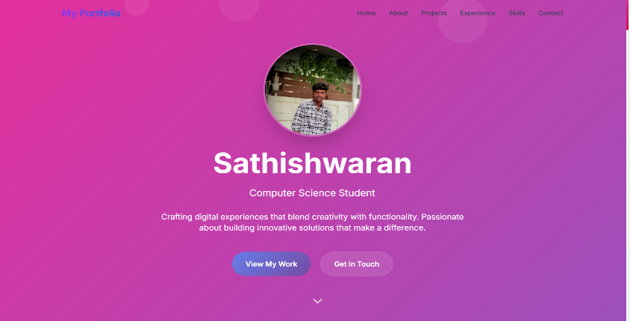
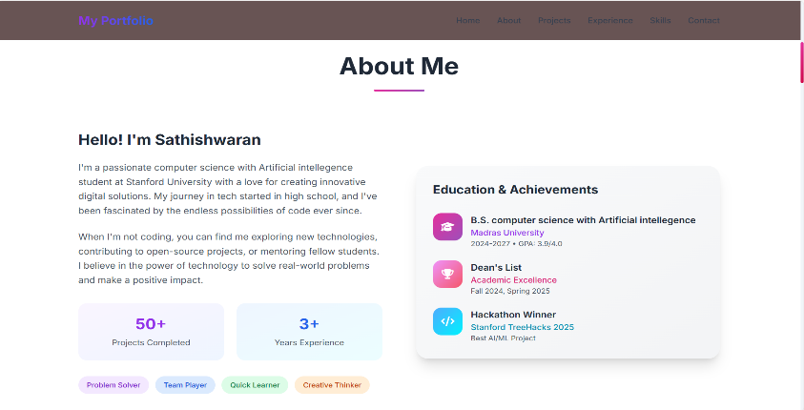
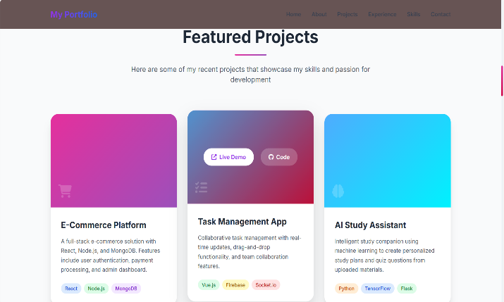
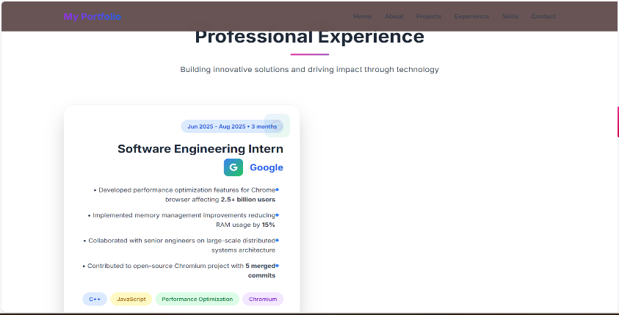
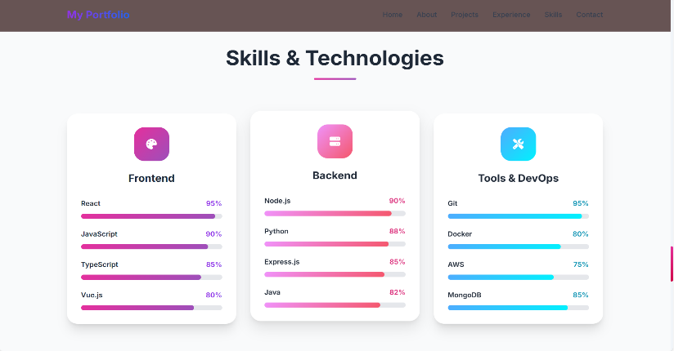
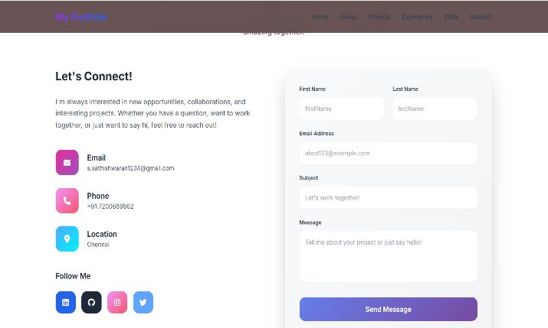
RESULTS AND SCREENSHOTS
3/21/2024 Annual Review
11

Slide 12
CONCLUSION
This portfolio website is a highly effective and professional tool for launching your tech career. It successfully addresses the problem statement by:
Creating a Powerful First Impression: The unique color scheme, smooth animations, and clean design immediately convey creativity and technical competence.
Effectively Demonstrating Your Skills: The structured sections allow you to present a compelling narrative of your journey, projects, and abilities.
Serving as a Practical Showcase: The site itself is a testament to your front-end development and design skills.
Facilitating Connections: The contact form and clear contact information make it easy for opportunities to find you.
12

